Slide 1




Slide 2



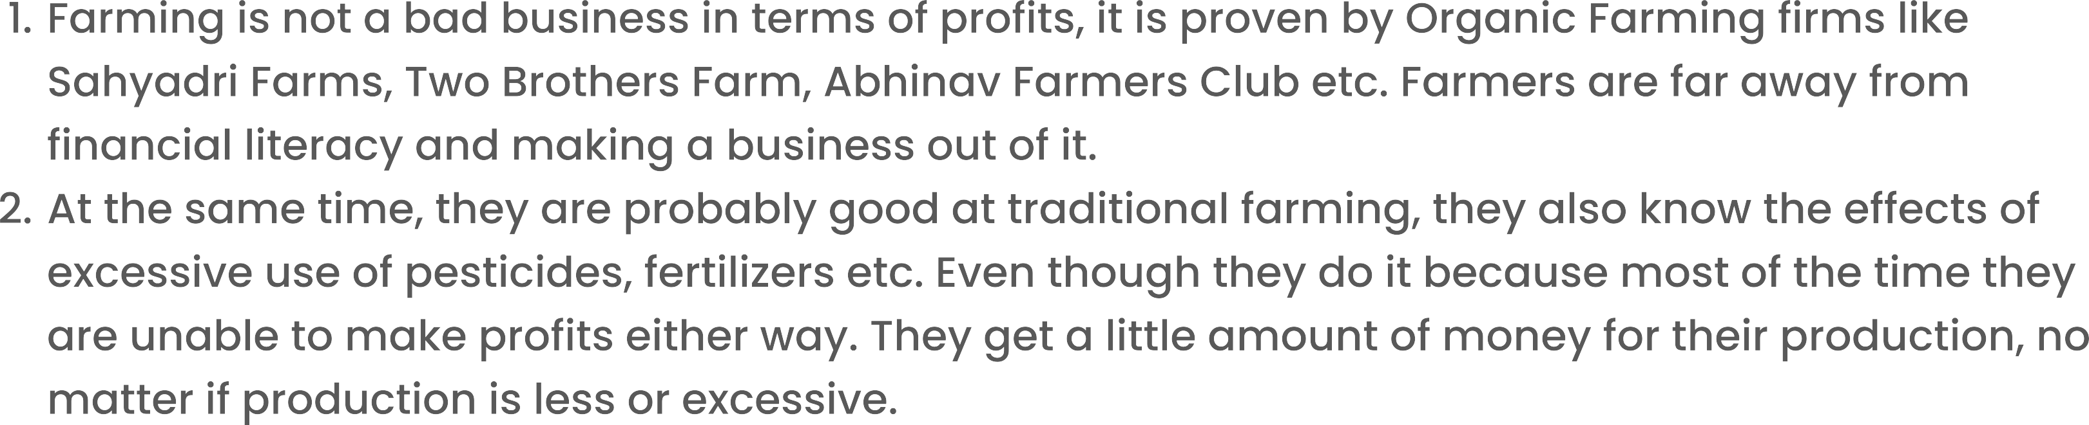

Slide 3
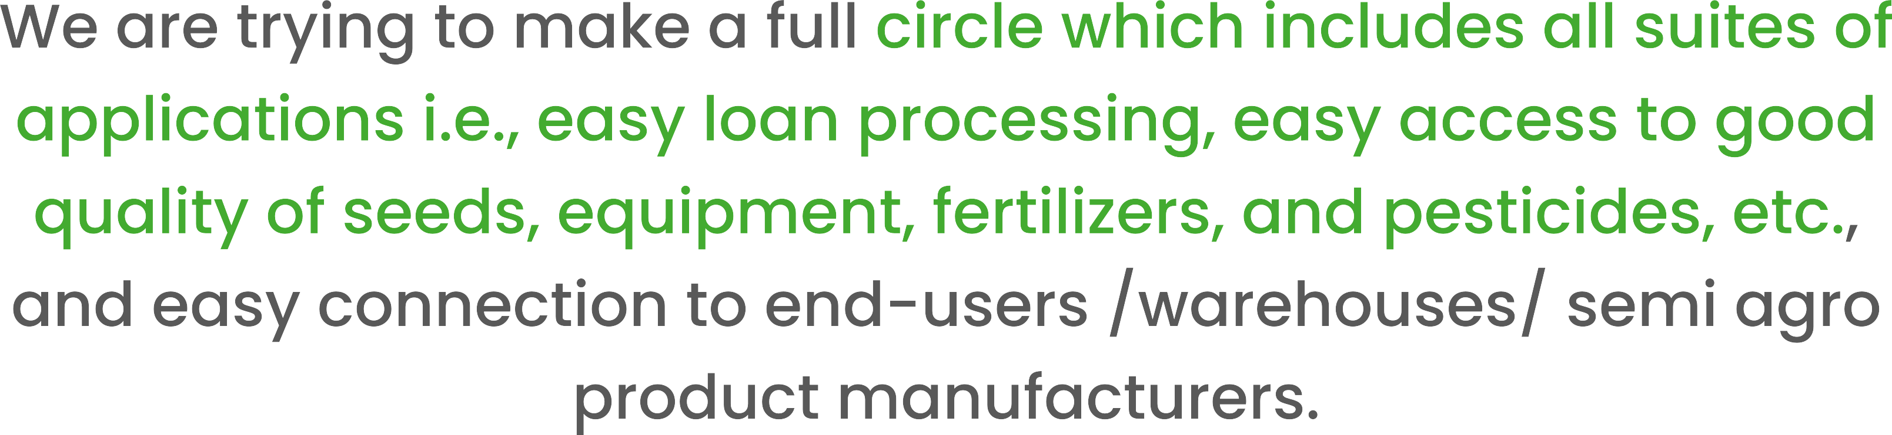

Slide 4

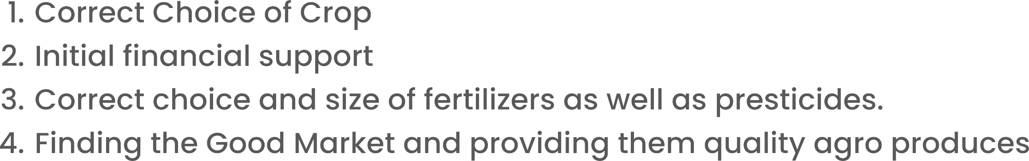

Slide 6

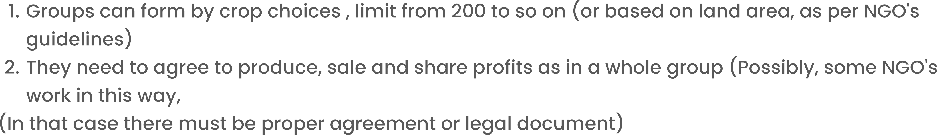

Slide 7
Since the center of interest is farmers, We want to solve as much as problems that arise and afraid farmers for doing farming.
We designed a full suite of applications (Named ShunyaNiti [नीति]) that will help whatever they need in the product lifecycle, following are the modules, farmers or participants of the cycle may register for module they interested in or be a part of a whole system.
ShunyaArtha (अर्थ) → Finance needs
ShunyaBazaar (बाजार) → Market Access- Sale and purchase farming related products
ShunyaSamadhan (समाधान) → Any farming-related advice, guidance
ShunyaSarathi (सारथी) → Transportation-related help
ShunyaGat (गट) → Group formation and collective farming
ShunyaShodh (शोध) → Innovations
ShunyaKothaar (कोठार) → Storage/warehousing solutions
ShunyaTantr(तंत्र) → Training and knowledge base about the use of technology (in farming, banking, etc.)

Slide 9
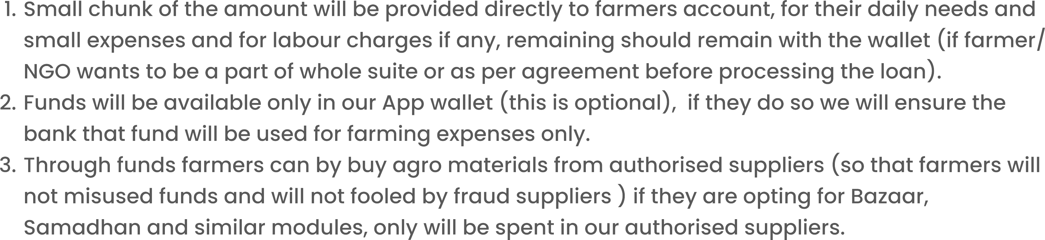

Slide 10

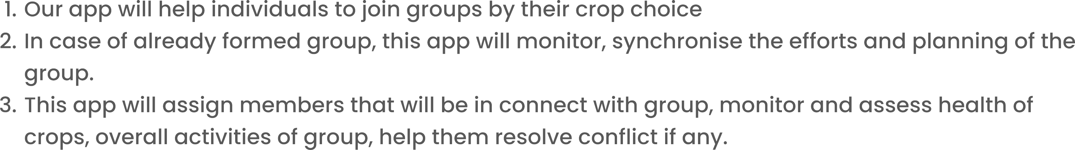

Slide 11
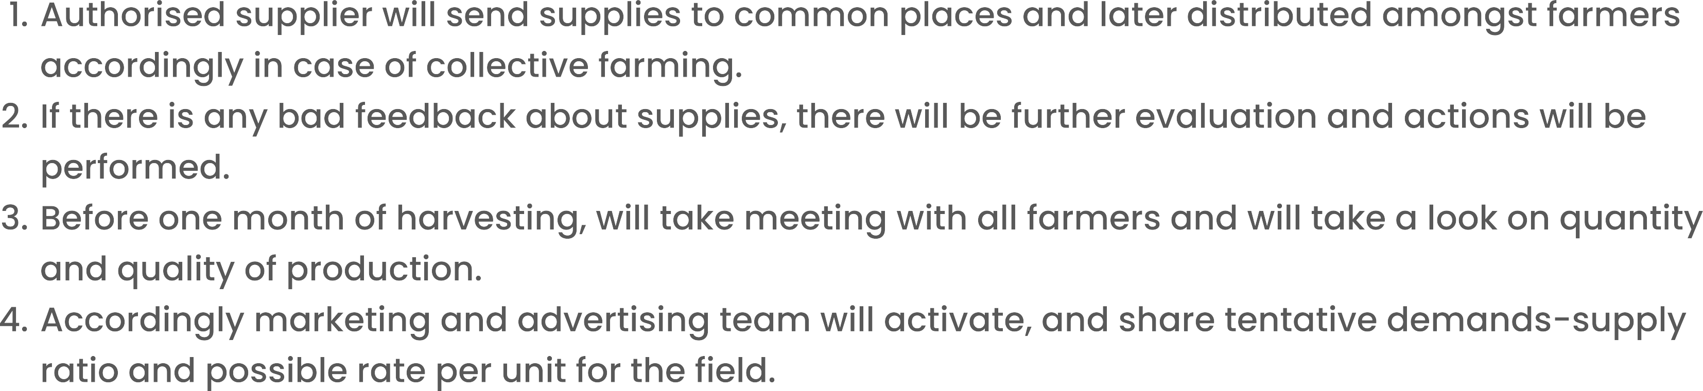

Slide 12

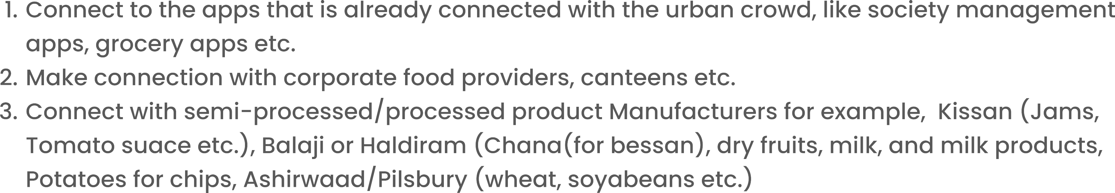

Slide 13

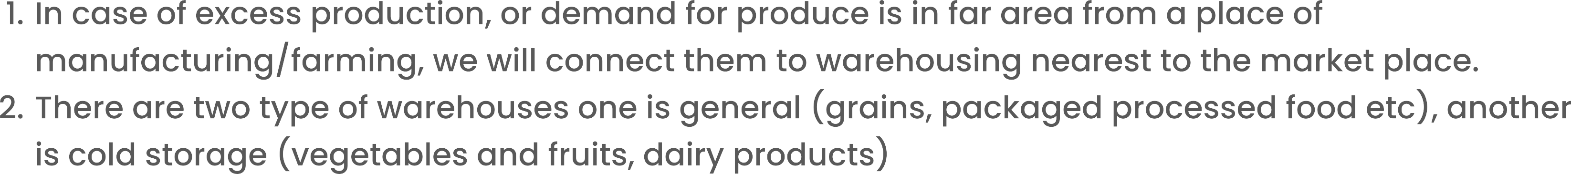

Slide 15

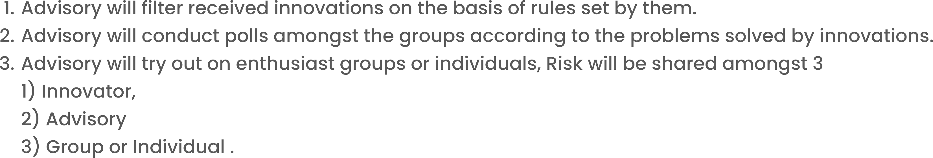

Slide 16


Slide 17



Slide 18

